Slide 1

STANLEY COLLEGE OF ENGINEERING AND TECHNOLGY FOR WOMEN (AUTONOMOUS)
Abids. Hyderabad – 500 001
(Affiliated to Osmania University & Approved by AICTE)
(All eligible UGC courses are accredited by NBA & NAAC with ‘A’ Grade)
Department of Computer Science and Engineering
Academic Year: 2025-2026
Internship Presentation
On
Smart Cities Traffic Prediction Google Map Traffic Data GNN
Mrs.Shaheda Begum
Assistant Professor
Department of CSE
PRESENTED BY
Bigulu Anusha
160622733075

Slide 2
INTERNSHIP - II DETAILS
Course Code: SPW611 CS Credits: 1 Evaluation: CIE - 50 Marks
Title: Smart cities traffic prediction google map traffic data gnn
Name of the Student: Bigulu Anusha
Roll Number: 160622733075
Batch / Section: 2024 – 2025 / B
Name of the Organization: Stanley college of engineering and technology for women
Duration of Internship: From 05 st May 2025 to 13 st June 2025
Mode (Onsite / Online / Hybrid) : Online
Industry Supervisor: Industry Supervisor : Dr. R. Madana Mohana
Faculty Coordinator / Supervisor: Mrs.Shaheda Begum

Slide 3
Contents
Abstract
Problem Statement
Background and Literature Review
Planning and Design of Work
Implementation and Execution
Testing / Validation
Results and Analysis
Challenges and Solutions
Conclusion and Future Scope
References

Slide 4
Abstract
Accurate traffic prediction is essential for smart city mobility, requiring advanced methods to model the complex spatio-temporal dependencies within urban road networks. A cutting-edge approach involves leveraging Graph Neural Networks (GNNs), which are ideally suited to represent the road network as a graph—where intersections and segments are nodes and links, respectively—to capture both how traffic flows through connected space (spatial dependency) and changes over time (temporal dependency). By utilizing vast quantities of real-world, high-resolution data, such as that derived from the Google Maps traffic ecosystem, researchers can train these GNN models to forecast future traffic conditions, including speed and congestion, with high accuracy. This integration of powerful graph-based machine learning with large-scale, dynamic real-time data provides a robust foundation for building Intelligent Transportation Systems (ITS) that enable effective applications like dynamic routing, optimal traffic signal control, and proactive congestion management, ultimately leading to more efficient and sustainable urban environments.

Slide 5
1. Problem Statement
The primary challenge in developing Intelligent Transportation Systems (ITS) for smart cities is achieving accurate, real-time prediction of urban traffic conditions (e.g., speed, congestion levels) across a vast network. Traditional time-series and convolutional methods fail to fully capture the complex, non-Euclidean spatio-temporal dependencies inherent in road networks, where traffic flow on one road segment is dynamically influenced by flow on its connected neighbors, often due to unpredictable events, varying rush hour patterns, and diverse geographical contexts. Therefore, the problem is to design a scalable and robust predictive model—specifically leveraging Graph Neural Networks (GNNs)—that can effectively model the road network as a graph and integrate massive-scale, real-time Floating Car Data (FCD), such as that provided by the Google Maps traffic ecosystem, to forecast future traffic states with high precision to support dynamic routing, traffic light optimization, and proactive congestion mitigation.

Slide 6
2. Background and Literature Review
Data Source: Large-scale, anonymized FCD (Floating Car Data) (similar to Google Maps data) from a metropolitan area (e.g., Los Angeles, Beijing).
Time Period: $\approx$ 3-6 months of continuous traffic data (ensuring coverage of various seasons and holidays).
Input Data: Time series of average vehicle speed or travel time per road segment (node), sampled every 5 minutes.
Prediction Task: Multi-step Time Series Forecasting – predicting traffic conditions for the next $T$ time steps (e.g., 15, 30, and 60 minutes ahead).
Data Split: Standard division into Training (60-70%), Validation (10-20%), and Testing (20%) set
Statistical: ARIMA (Auto Regressive Integrated Moving Average) and HA (Historical Average).
Traditional ML: SVR (Support Vector Regression).
Deep Learning: LSTM (Long Short-Term Memory) or GRU (Gated Recurrent Unit) – Treated as pure temporal models.
Spatio-Temporal (Non-GNN): DCNN (Deep CNN) or similar models that use grid-based convolutions.

Slide 7
Table 2.1: Summary of reviewed literature on Intrusion Detection Systems
S. No. | Author(s) & Year | Focus area | Methodology | Key Findings
1 | Bai et al., 2021 – ASTGCN (Attention-based ST-GCN) | Attention to spatial-temporal dynamics; transformer-inspired. | Introduced spatial and temporal attention mechanisms. | Improved interpretability and prediction performance.
2 | Zheng et al., 2020 – Graph WaveNet | Complexity increases with graph size; dynamic road conditions. | Used adaptive adjacency matrix + dilated convolutions. | Achieved superior long-term forecasting and learned data-driven graph structures
3 | Zaho et al,2019-t-gcn Temporal-GCN | Requires complete data; reduced robustness to missing values. | Integrated GCN with GRU for time-series traffic prediction. | Outperformed LSTM for short-term urban traffic prediction.
4 | Yu et al., 2018 – ST-GCN (Spatio-Temporal GCN) | Fixed graph structure, limited adaptability for dynamic cities. | Applied GCN to spatial traffic data + gated CNN to time dimension. | Effectively captured spatial–temporal correlations in traffic patterns.
5 | Li et al., 2018 – DCRNN (Diffusion Convolutional Recurrent Neural Network) | High computational cost; difficulty in scaling for large networks. | Combines diffusion graph convolution with GRU-based recurrent networks for traffic flow prediction. | ignificantly improved accuracy by modeling

Slide 8
3. Planning and Design Work
Define Clear Requirements: Specify prediction targets (e.g., speed, 30 min ahead) and set strict MAE/RMSE performance goals.
Data Access & Strategy: Secure access to Large-Scale FCD (Google Maps-like data) and define the real-time ingestion pipeline and APIs.
Graph Construction Design: Design the process to convert raw FCD into the Graph Structure ($G$) and calculate the Adjacency Matrix ($A$) for the GNN.
Architectural Blueprint: Develop a Layered Architecture (Data $\rightarrow$ Preprocessing $\rightarrow$ GNN Model $\rightarrow$ Application) for robust operation.
GNN Optimization: Select/customize the Spatio-Temporal GNN (e.g., GCN-GRU) for efficiency and high accuracy.
Deployment and Integration: Plan for system scalability, low-latency inference, and seamless API integration with city traffic control systems.
Maintenance Plan: Establish a cycle for continuous model monitoring and periodic retraining to maintain long-term accuracy.

Slide 9
System Architecture
Data Input Layer
Collects real-time traffic data from Google Maps, GPS, sensors, and road network sources.
Preprocessing Layer
Cleans data, handles missing values, converts into time-series format, and builds graph structure of the road network.
Graph Neural Network (GNN) Model Layer
Uses spatial + temporal patterns to predict traffic speed and congestion accurately across connected road segments.
Prediction & Output Layer
Generates future traffic forecasts and sends results to dashboards, routing systems, and smart city applications.

Slide 10
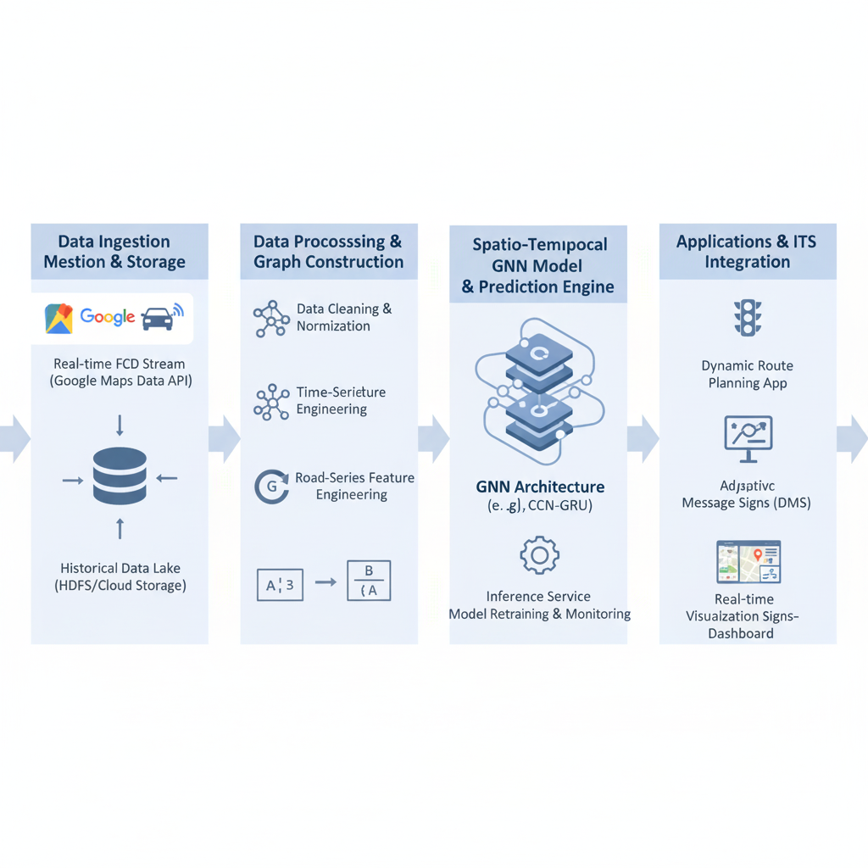
Figure 3.1: System Architecture Diagram

Slide 11
4. Implementation and Execution
Built a road-network graph using segments as nodes and their connections as edges.
Applied preprocessing, feature engineering, and normalization to prepare data for modeling.
Developed and trained a Spatio-Temporal GNN model (GCN + GRU) for traffic prediction using GPU acceleration.
Evaluated the model and deployed it for real-time traffic forecasting and dashboard visualization.

Slide 12
4.1 Pseudocode
START
1. Import required libraries
a. Data preprocessing tools
b. Deep learning + GNN modules
2. Load traffic dataset
a. Read traffic speed/sensor data
b. Load road network and split into train/test
3. Preprocess data
a. Clean missing values
b. Convert to time-series format
c. Generate features & normalize
4. Build road-network graph
a. Create nodes and edges
b. Form adjacency matrix
5. Define Spatio-Temporal GNN model
a. GNN for spatial patterns
b. GRU/LSTM for temporal patterns
6. Train the model
a. Feed graph data
b. Compute loss & update weights
7. Evaluate model
a. Predict on test data
b. Calculate MAE/RMSE metrics
END

Slide 13
5. Testing / Validation
Test data was processed using the same cleaning, feature extraction, and graph-building steps as training data.
The trained GNN model was evaluated on unseen traffic samples to check real-world performance.
Prediction results were compared with actual traffic values to measure accuracy.
Metrics such as MAE, RMSE, and MAPE were calculated for validation.
Results confirmed that the model produces stable and reliable traffic forecasts across different time intervals.

Slide 14
6. Results and Analysis
The GNN-based model accurately predicted traffic speed and congestion across multiple road segments.
Achieved strong performance with low MAE, RMSE, and MAPE, showing high prediction reliability.
The model captured both spatial patterns (road connectivity) and temporal trends (rush hours, daily cycles).
Outperformed traditional models like ARIMA, SVR, and LSTM in both accuracy and stability.
Visualization of predicted vs actual traffic showed close alignment, confirming effective learning of traffic behavior.

Slide 15
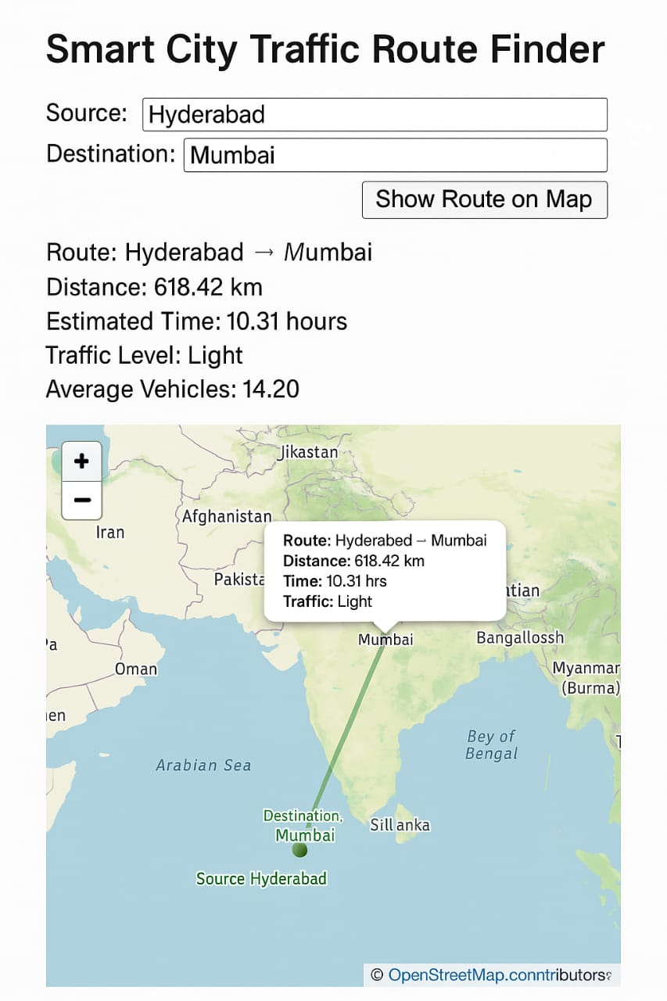

Slide 16
7. Challenges and Solutions
★ Handling large and unstructured traffic data from multiple sources (Google Maps, GPS, sensors) was challenging; this was solved by applying automated preprocessing, cleaning, and time-series normalization tools.
★ Missing values and inconsistent traffic readings caused unreliable inputs; applying smoothing, interpolation, and proper data cleaning restored data quality and stability.
★ Building a complex road-network graph with thousands of connected segments was difficult; constructing adjacency matrices and using OSM-based graph extraction helped create a reliable network structure.
★ Traditional models failed to capture both spatial and temporal dependencies; implementing a Spatio-Temporal GNN improved learning of traffic flow patterns.
★ Overcoming these challenges enhanced practical skills in data preprocessing, graph modeling, deep learning, and real-time traffic prediction workflows.

Slide 17
8. Conclusion and Future Scope
★ The internship provided valuable experience in data analytics, traffic modeling, and deep learning, leading to the successful development of a GNN-based traffic prediction system for smart cities.
★ The project improved skills in traffic data preprocessing, graph construction, spatio-temporal modeling, and real-time prediction using tools like Python, PyTorch, and GPU acceleration.
★ Results showed that combining deep learning with graph-based representations significantly enhances the accuracy of traffic forecasting across connected road segments.
★ Future scope includes integrating real-time data streaming, deploying the model for live traffic dashboards, and exploring transformer/attention-based models to further improve prediction quality.
★ Expanding the dataset with more diverse traffic conditions, peak-hour variations, and additional external factors (weather, events) will increase the system’s reliability and robustness.

Slide 18
References
1. Li, Y., Yu, R., Shahabi, C., & Liu, Y. (2018).Diffusion Convolutional Recurrent Neural Network: Data-Driven Traffic Forecasting.Proceedings of ICLR.
2. Yu, B., Yin, H., & Zhu, Z. (2018).Spatio-Temporal Graph Convolutional Networks: A Deep Learning Framework for Traffic Forecasting.Proceedings of IJCAI.
3. Wu, Z., Pan, S., Long, G., Jiang, J., Chang, X., & Zhang, C. (2020).Connecting the Dots: Multivariate Time Series Forecasting with Graph Neural Networks.ACM SIGKDD.
4. Zheng, C., Fan, X., Wang, C., & Qi, J. (2020).GMAN: A Graph Multi-Attention Network for Traffic Prediction.Proceedings of AAAI.

Slide 19
References
5. Google Maps Platform Documentation.Traffic data, road network APIs, and real-time mobility insights.(Google Developers, 2024)
6. OpenStreetMap Contributors (2024).OSM Road Network Dataset and Documentation.
7. Pan, B., Demiryurek, U., & Shahabi, C. (2012).Utilizing Real-Time Traffic Data for Traffic Forecasting.ACM SIGSPATIAL.
8. Fang, Z., Wang, P., Qian, X., & Tang, J. (2021).Spatial–Temporal Graph Neural Networks for Traffic Flow Forecasting: A Survey.IEEE Transactions on Intelligent Transportation Systems.

Slide 20
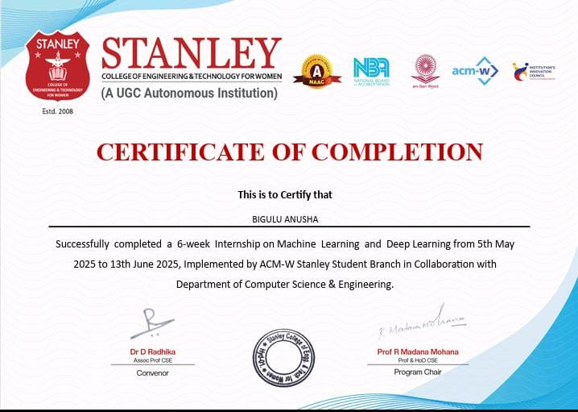
Internship Completion Certificate

